Slide 1

A Project Review Meeting on Student Wellness & Fitness Tracker
By
Name V. Rukesh roll 2520030519
Name V. Satish roll 2520030302
Team Number : 1
Under the guidance of
Ms. D.Pavithra Assistant Professor
Department of Computer Science and Engineering
Koneru Lakshmaiah Education Foundation (Deemed to be University estd. u/s. 3 of the UGC Act, 1956) Off-Campus: Bachupally-Gandimaisamma Road, Bowrampet, Hyderabad, Telangana - 500 043. Phone No: 7815926816, www.klh.edu.in

Slide 2
Outline of the Presentation
Abstract
Introduction
Problem Statement
Project Flow Diagram
Objectives with Justification
Modules[Frontend web pages]
Expected Outcomes of the Proposed Work
Conclusion
References

Slide 3
Abstract
Student Wellness & Fitness Tracker is a web-based application designed to help students monitor and improve their physical and mental well-being. The system enables users to track daily fitness activities, water intake, sleep duration, calorie consumption, and mood status. By providing personalized insights and progress reports, the application encourages healthy habits and promotes a balanced lifestyle among students. The platform offers an intuitive interface for recording health-related data and visualizing progress through dashboards and charts. This project aims to increase health awareness, improve fitness management, and support students in maintaining overall wellness while balancing academic responsibilities.

Slide 4
Introduction
In today's academic environment, students often experience stress, irregular sleep patterns, poor dietary habits, and insufficient physical activity. These factors can negatively affect both academic performance and overall health. A Student Wellness & Fitness Tracker provides a centralized platform where students can monitor various health parameters such as exercise routines, sleep schedules, hydration levels, calorie intake, and emotional well-being.
The system uses modern web technologies to collect and analyze user data, providing meaningful insights and recommendations. By encouraging self-monitoring and healthy lifestyle choices, the application helps students maintain physical fitness and mental wellness, ultimately contributing to improved productivity and quality of life.

Slide 5
Problem Statement
Many students struggle to maintain healthy lifestyles due to busy schedules, academic pressure, and lack of awareness about their health habits. Existing fitness applications are often designed for general users and may not address the specific wellness needs of students.
The proposed Student Wellness & Fitness Tracker aims to provide a dedicated platform where students can:
Track daily fitness activities.
Monitor sleep and hydration habits.
Record calorie intake and nutrition details.
Assess mental wellness through mood tracking.
View personalized health reports and recommendations.

Slide 6
Project Flow Diagram
┌─────────────┐
│ Start │
└──────┬──────┘
│
▼
┌─────────────┐
│ User Login │
│ / Register │
└──────┬──────┘
│
▼
┌─────────────┐
│ Dashboard │
└──────┬──────┘
│
┌──────┼──────────────┬─────────────┬─────────────┐
│ │ │ │
▼ ▼ ▼ ▼ ▼
Sleep Water Fitness Nutrition Mood
Track Intake Activities Tracking Tracking
│ │ │ │ │
└──────┴──────────────┴─────────────┴─────────────┘
│
▼
┌─────────────────┐
│ Data Analysis & │
│ Progress Report │
└────────┬────────┘
│
▼
┌─────────────────┐
│ Recommendations │
└────────┬────────┘
│
▼
┌────────┐
│ End │
└────────┘

Slide 7
Objectives with Justification
Objective | Justification
Monitor physical fitness activities | Encourages students to maintain regular exercise routines.
Track sleep patterns | Helps identify unhealthy sleeping habits that affect academic performance.
Monitor hydration levels | Promotes adequate water consumption for better health.
Track calorie intake and nutrition | Encourages healthy eating habits and balanced diets.
Monitor mood and mental wellness | Helps students identify stress patterns and emotional changes.
Generate health reports | Provides valuable insights into overall wellness progress.
Promote healthy lifestyle habits | Supports long-term physical and mental well-being.
Objective | Justification

Slide 8
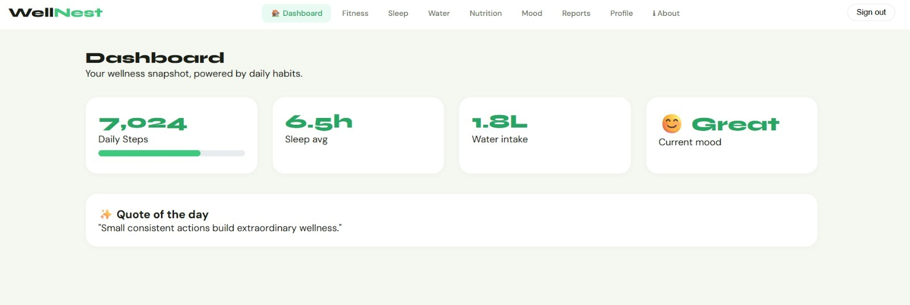
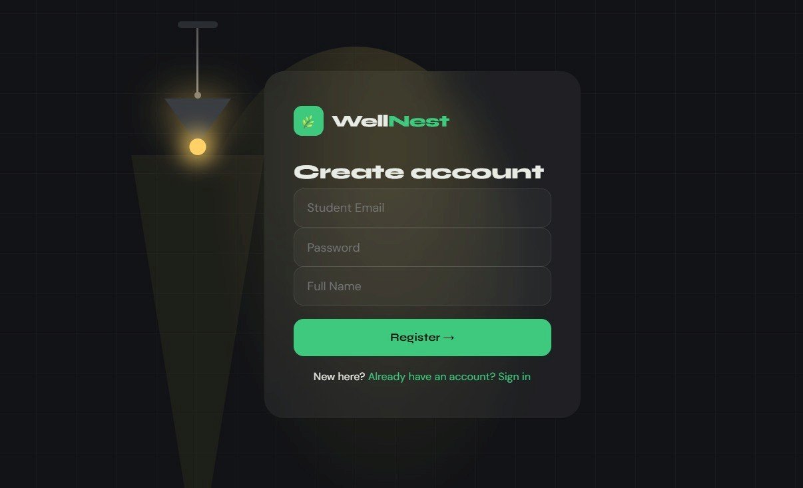
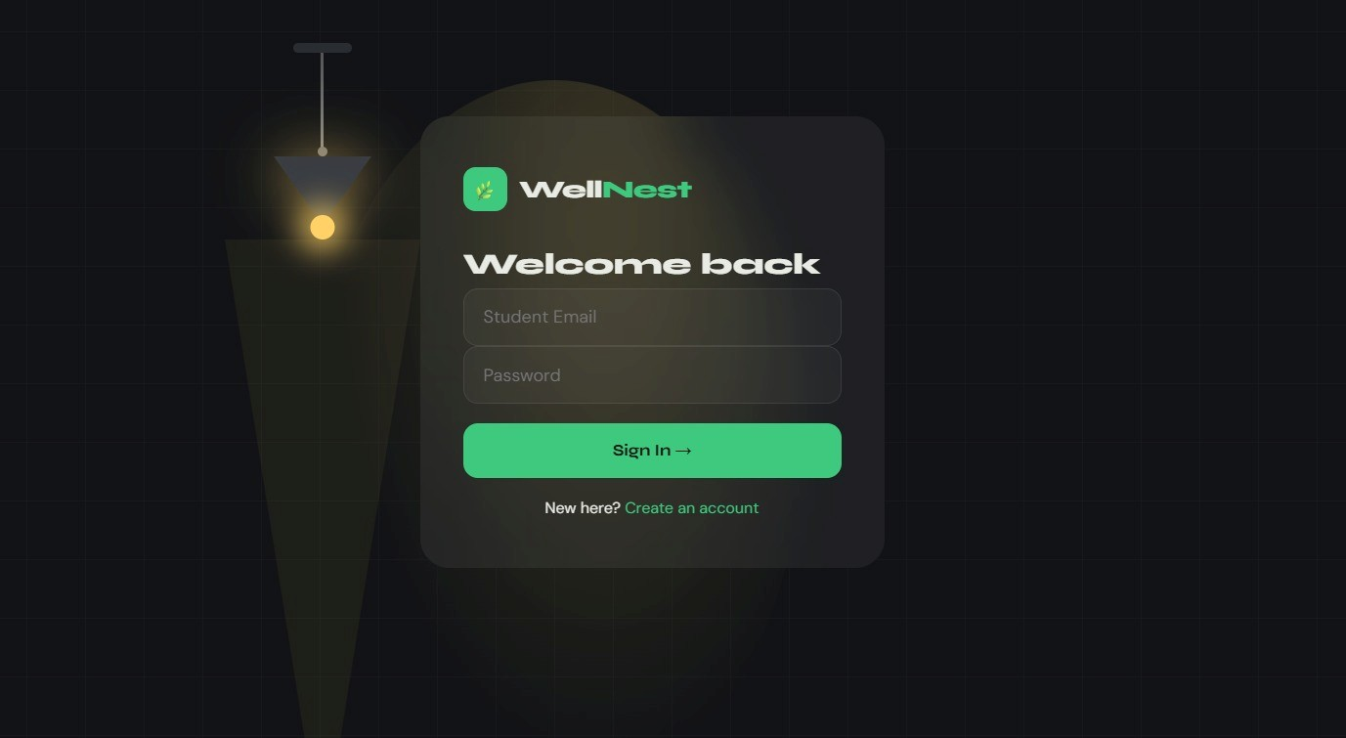
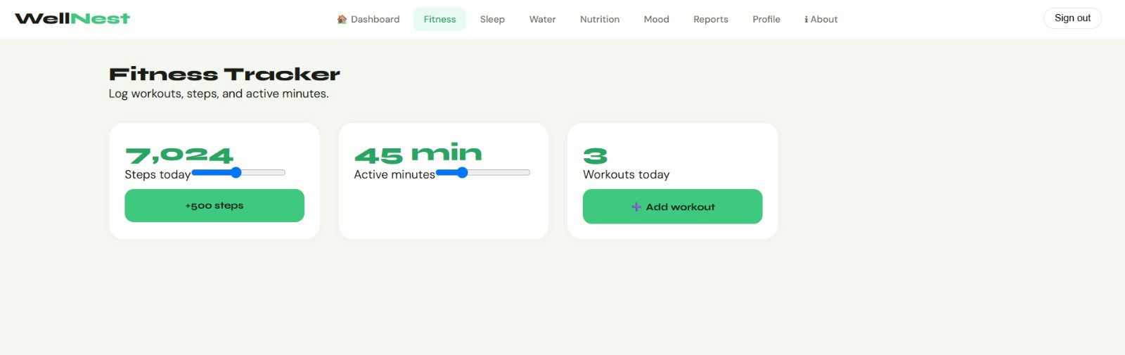
Modules [Frontend web pages]
Home page
Registration Page
Login Page
Fitness Tracker

Slide 9
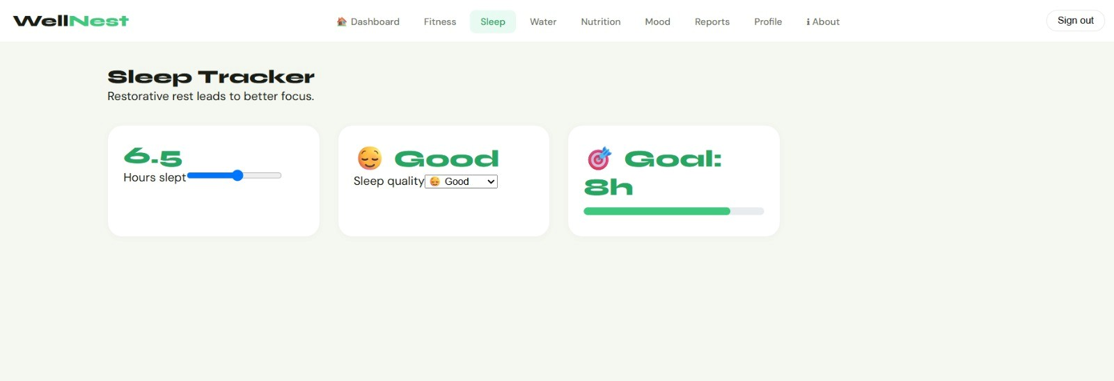
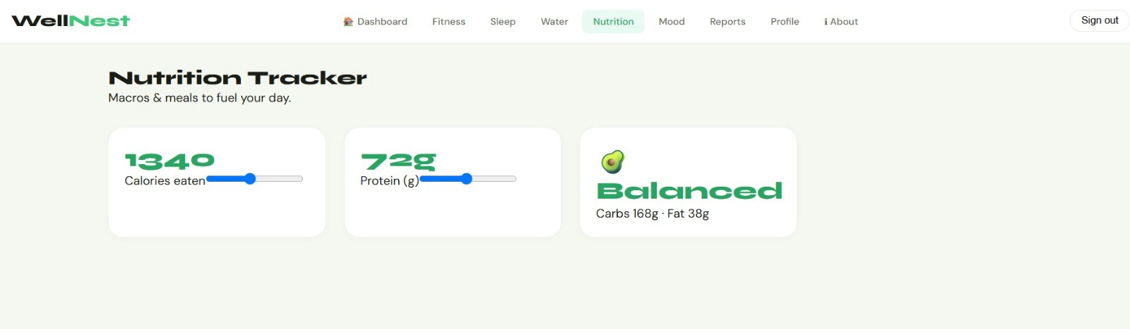
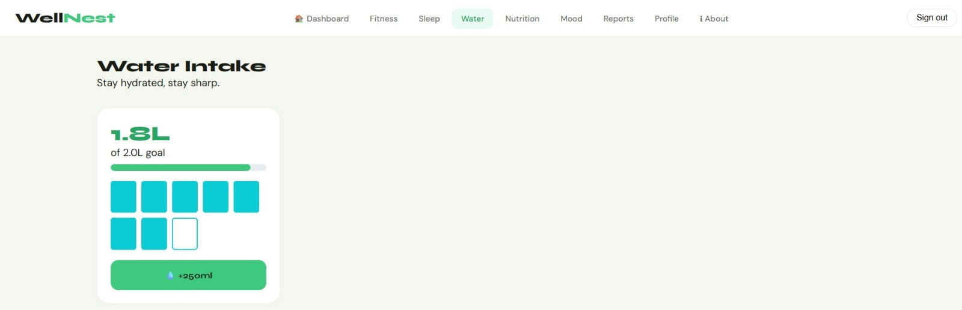
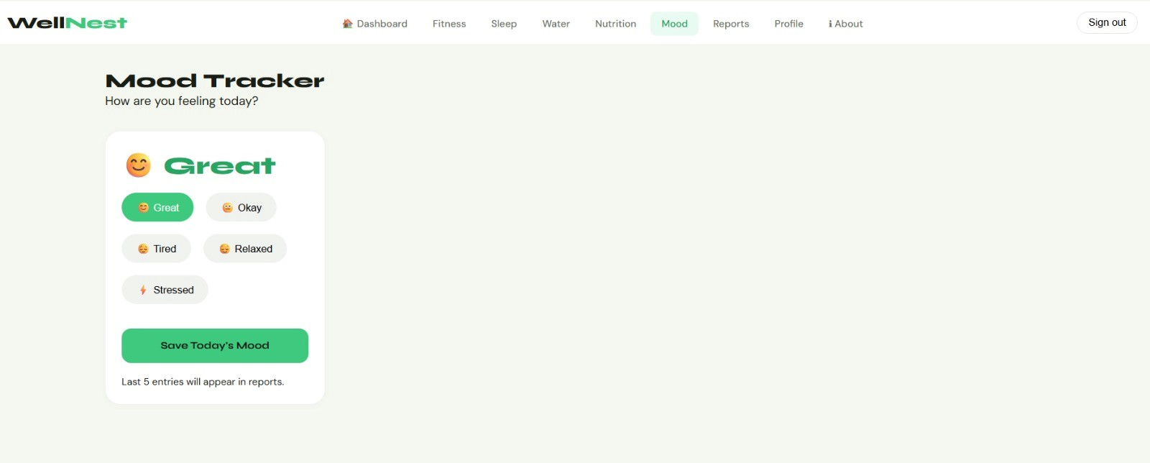
Sleep Tracker
Nutrition Tracker
Water Intake Tracker
Mood tracker

Slide 10
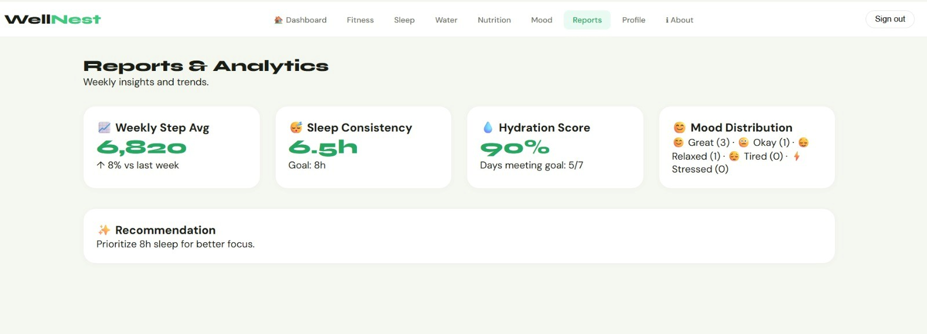
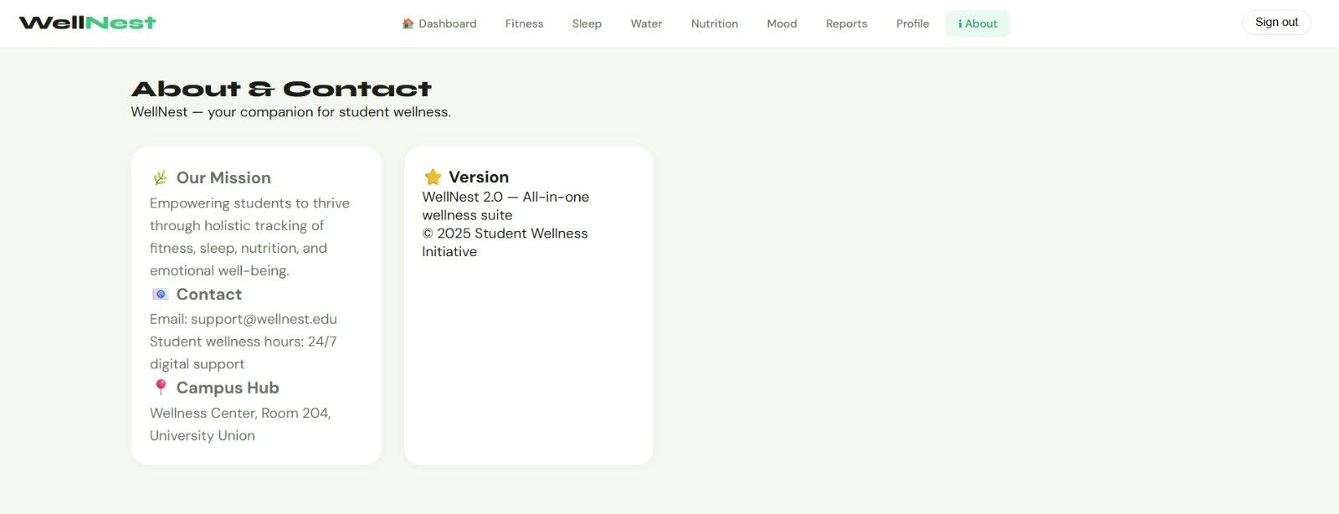
Reports and Analytics
Profile Page
About / Contact Page

Slide 11
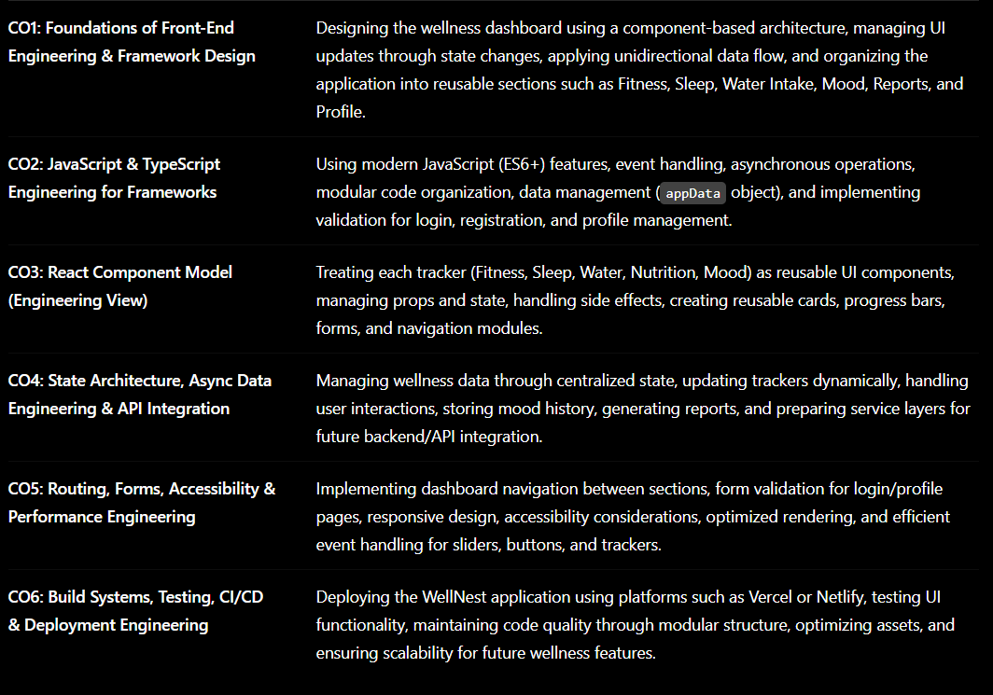
CO Mapping

Slide 12
Expected Outcomes of the Proposed Work
Improved awareness of personal health and wellness.
Better management of fitness and daily activities.
Increased physical activity among students.
Improved sleep quality and hydration habits.
Better stress management through mood tracking.
Availability of personalized health insights and recommendations.
Enhanced overall well-being and academic productivity.

Slide 13
Conclusion and Future Scope
Conclusion
The Student Wellness & Fitness Tracker provides a comprehensive solution for monitoring and improving student health and wellness. By integrating fitness tracking, wellness monitoring, goal management, and progress analysis into a single platform, the system encourages students to adopt healthier lifestyles. The application helps users maintain consistency in their wellness activities while providing valuable insights into their overall health. The successful implementation of this project can significantly contribute to improving student well-being, productivity, and academic performance.
Future Scope
Integration with wearable fitness devices.
AI-based personalized health recommendations.
Real-time health monitoring.
Mobile application development for Android and iOS.
Integration with college wellness programs.
Mental health assessment and counseling support.
Social fitness challenges and group activities.
Gamification features such as rewards and achievement badges.
Cloud-based health data synchronization.
Emergency health alert system.

Slide 14
References

Slide 15
Thank you

